Slide 1
Prod Replay – STS Demo
30-Sep-19

Slide 2
AGENDA
Prod-Replay Overview
Prod-Replay Solution ENGINES
DEMO
CURRENT STATE Vs FUTURE STATE OF RARE SOLUTION

Slide 3

Prod-Replay Automation Benefits

Slide 4
Prod-Replay Overview
Purpose
No Regression impact on Existing BAU
Arrest defect leakage into production
Cover uncovered scenarios/pattern missed during regression
Current Problems
No Coverage on Patterns/Scenarios
Huge Manual Effort for multi-country testing
Kind of Black Box Testing
No detailed comparison of test output and report
Prod-Replay
Solution to Problem
Identify prod patterns/Scenarios
Match and Stitch Patterns
Facility to run for specific country & patterns
Full Automation of Prod Replay
Detailed comparison of multiple hops messages
Report of patterns covered and compared in the test
Major Features in the Upcoming or Phase II
Multiple file format support like (JSON)
Bulk Payments
UI for the prod-replay tool and easy user access
UI for updating config files and entry to DB
Support SCPAY Systems & Solace
Single Dashboard for all countries RARE
Creation of Stub for Down Stream Systems

Slide 5
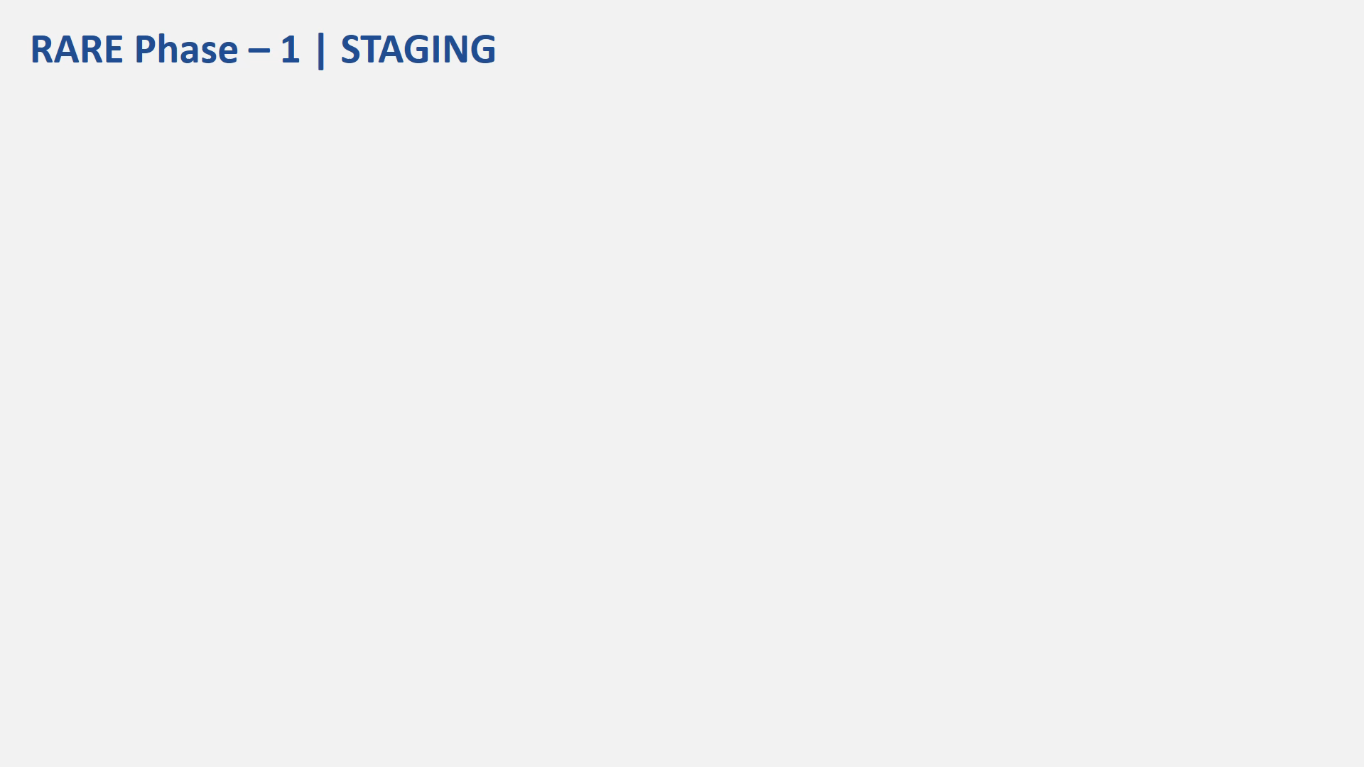
Sorting & Execution Engine

Slide 6

STAGING & EXECUTION ENGINE
STAGING ENGINE
EXECUTION ENGINE
Raw Logs
Message Logs (Xml, Json)
Channel Req.
Channel Request
Sort Prod files
Country
Products
Sub-Products
Channels
EXTRACTION
ENGINE
SORTING
ENGINE
MESSAGE INJECTION
Extract Unique Identifier from the logs and rename files with identifiers
Test Message Logs
STITCHING
ENGINE
EXTRACTOR + STITCHING
ENGINE
Test
Raw Logs
Stitch a transaction using Req & Res using combinations of Identifier
PATTERN
ENGINE
Identify Patterns using upstream/channels response
Valid Pattern
Exceptional Pattern
Invalid Pattern (missing legs)
VALIDATION
ENGINE
Messages for Pushing and Validation
RARE Results
5

Slide 7
DEMO
PRODUCT - FASTER PAYMENTS (INDIA IMPS)
MESSAGE FILE FORMAT – PAIN (XML)
PAYMENT TYPE – SINGLE PAYMENT
CHANNELS – IBK

Slide 8
CURRENT Vs FUTURE STATE OF PROD-REPLAY SOLUTION
CATEGORY | CURRENT STATE | NEAR FUTURE STATE | Phase II
File Formats | Supports only XML | Supports XML, JSON | Any future file formats
Payment Types | Supports Single Payments | Supports Single and Bulk Payments | -
HOPS Validation | Requests Send to Down Stream & Response to Upstream | NA | -
Database | DB2 (Complex Maintenance) | *MYSQL | -
RARE Execution Environment | Cloud Environment Provision is In-Progress (At present all are in Git hub or Local Env) | Dedicated Environment | -
Staging Engine | Build in two ways Built in Java, Involves files and data – End to end script, right from sorting, extracting to posting payments, comparing Prod files vs Test files and generating results in extent reports All work items are processed in the backend using database, file movement only at last stage | Improvisation and Enhancement of Engine | UI to be developed
Execution Engine | Build in Java Framework | Improvise and bring performance improvements | Implementation of a framework (like Citrus) other than Java Support SCPAY systems, Solace etc..
Execution Reporting | Extent Report & HTML | Single Dash Board for All products
Stub | - | - | Creation of Stubs for Down Stream Systems
* Require an Environment with MYSQL DB Installed & Required permissions to be provided

Slide 9
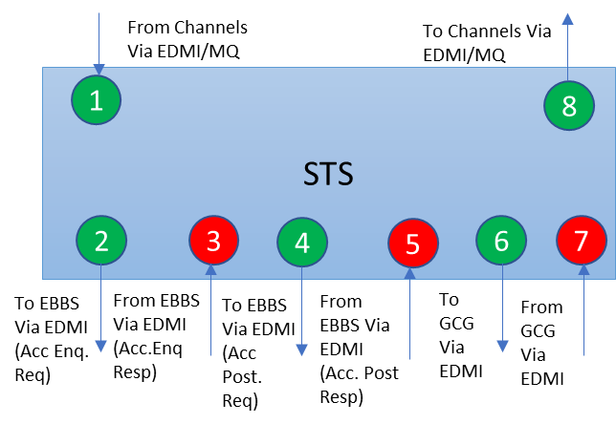
RARE COVERAGE
Schematic Rep of STS System
Phase I – With available Downstream systems
Phase II – Stubbed Downstream systems
Channel Request via Tool
Channel Response received by Tool
channel request
STS
API
Key Notes
SCB should provide files for all Hops
Hops 2,4,6,8 – Will be validated against production messages
For Phase 1 Hops 3, 5 &7 will not be qualifier
Not all countries will have Account enquiry (2,3)
For Phase 1 Hops 3, 5 &7 will not be qualifier
Via EDMI
Via MQ Hub
Downstream System - 1
Downstream System - 2
Downstream System - 3

Slide 10
Prod-Replay Solution Architecture

